Slide 1

This is the end!
Thank you for your attention.
Cheng-Jun Wang
wangchengjun@nju.edu.cn

Slide 2

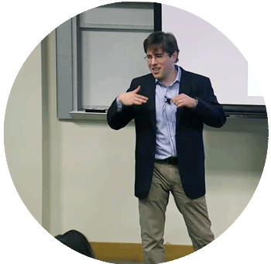

Bit by Bit is an invaluable resource for social scientists who want to harness the research potential of big data and a must-read for data scientists interested in applying the lessons of social science to tomorrow's technologies.
Matthew J. Salganik is professor of sociology at Princeton University
Cheng-Jun Wang
wangchengjun@nju.edu.cn

Slide 3
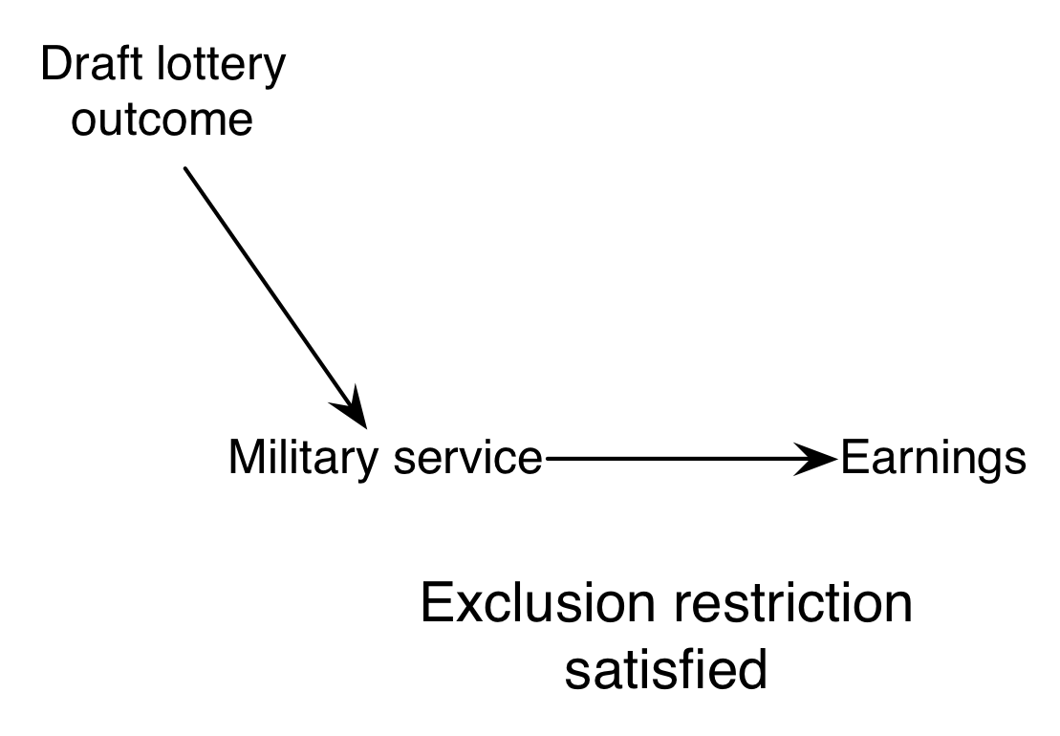
Z
ρ=Φ*λ
ITT_{Y} = ITT_{W} * CACE
Φ
ITT_{W}
Y
X
CACE
λ

Slide 4
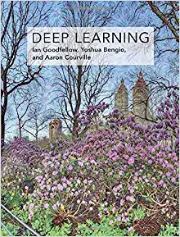

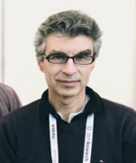
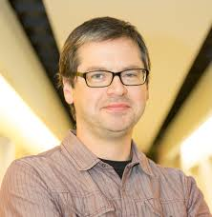
Deep Learning
Ian Goodfellow, Yoshua Bengio and Aaron Courville
2016 MIT Press
http://www.deeplearningbook.org

Slide 5
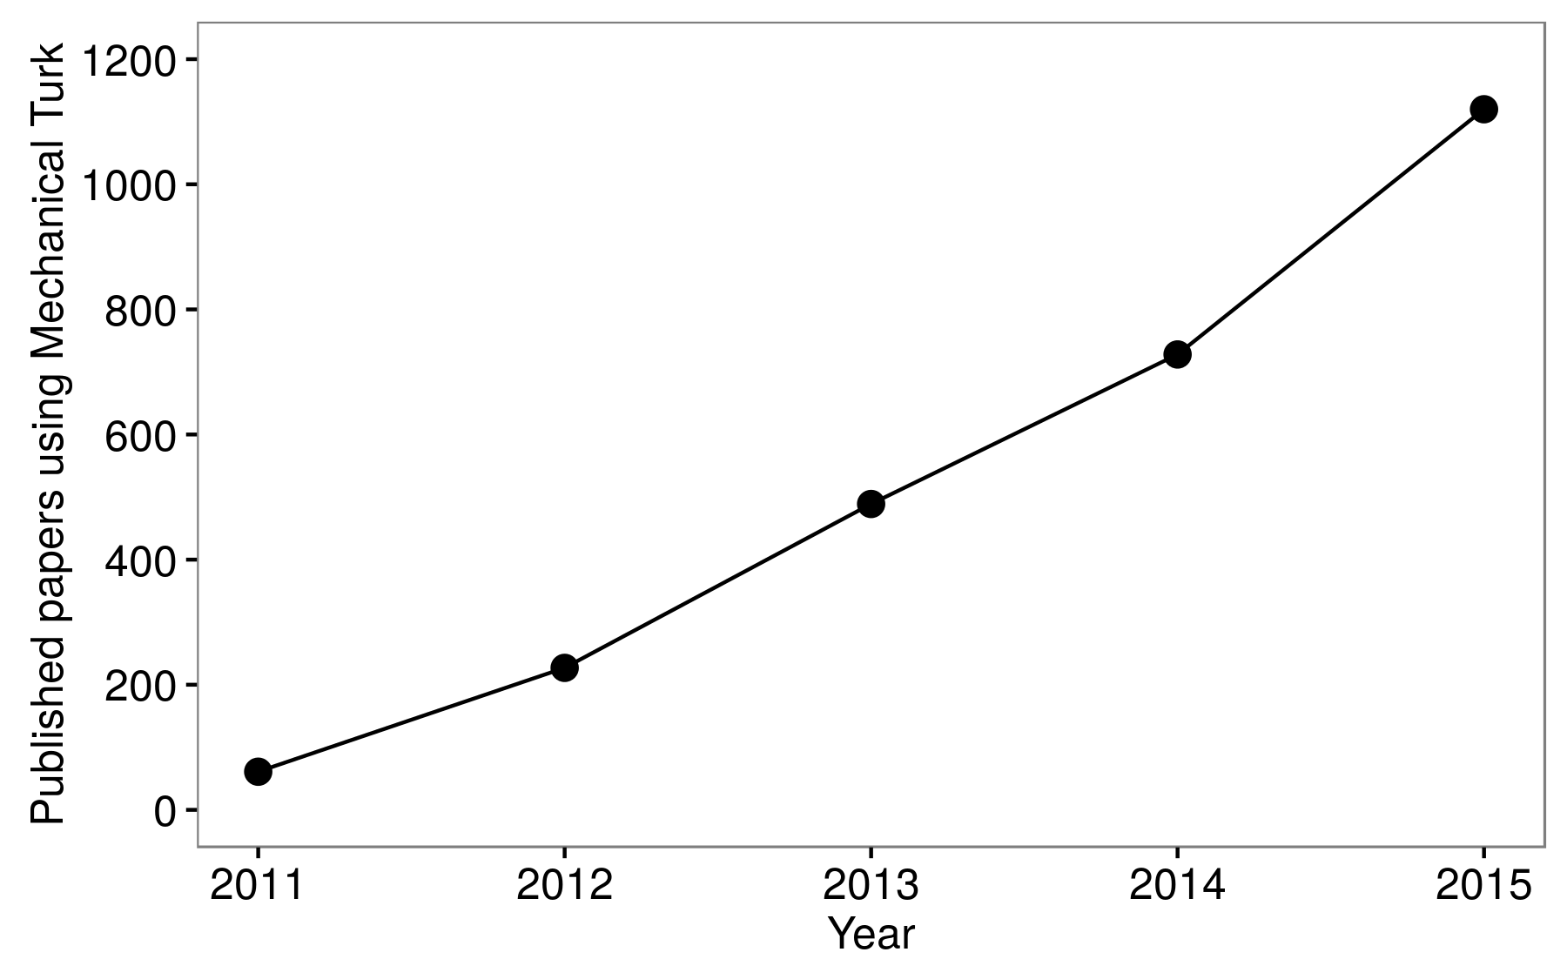

Slide 6

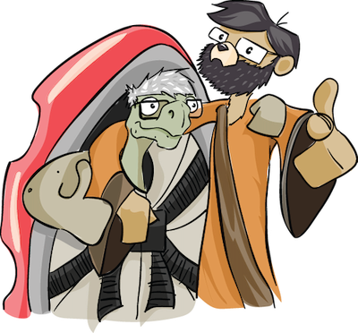
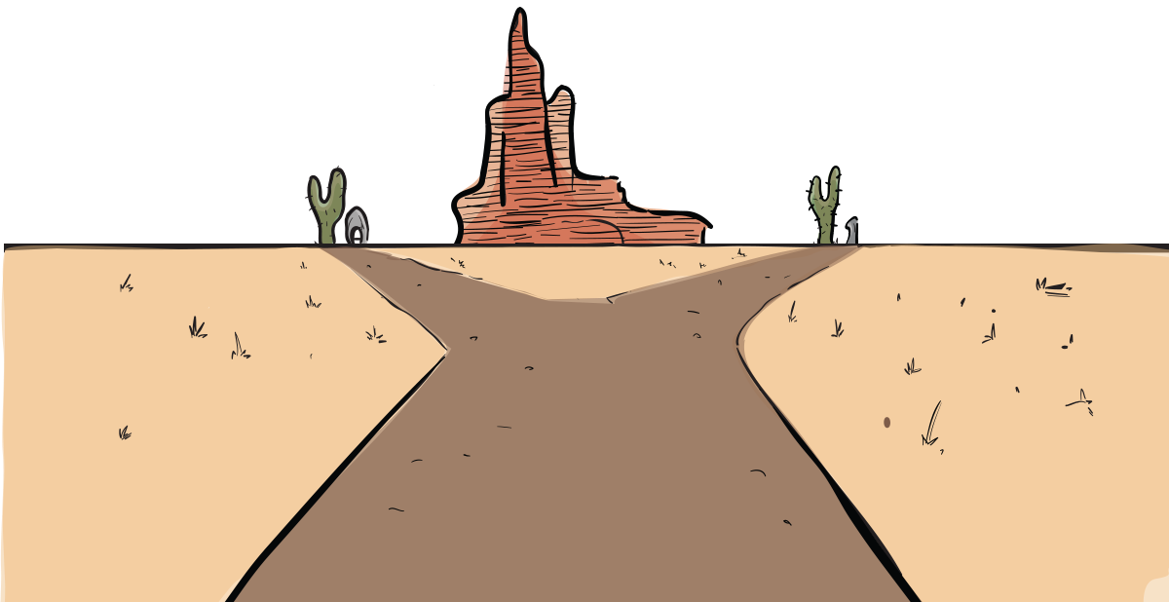
Joshua D. Angrist
Jörn-Steffen Pischke
Mastering ‘Metrics
The Path from Cause to Effect

Slide 8
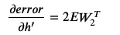
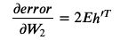
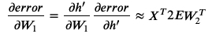
y = h’W₂
h’= relu(h)
h = X W₁
w₂
X
w₁
Computational Graph

Slide 9
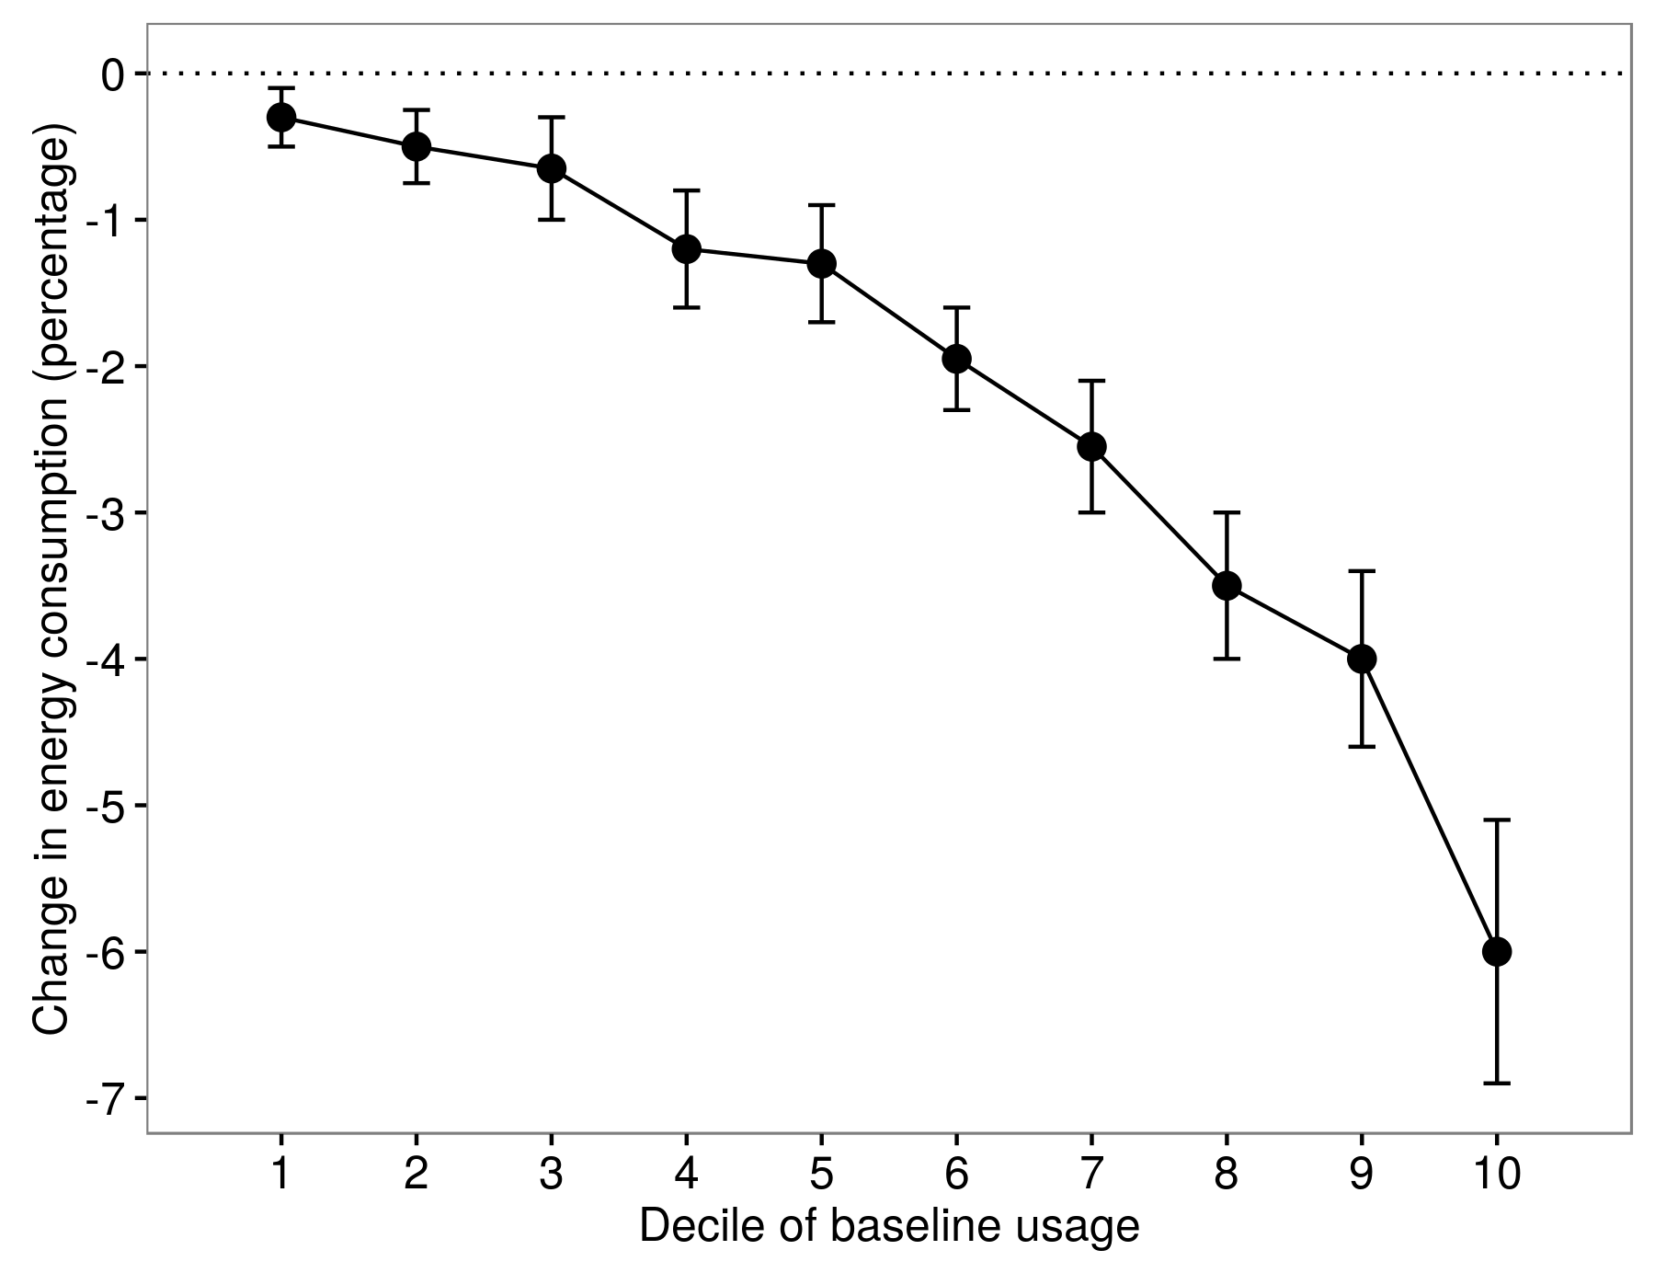
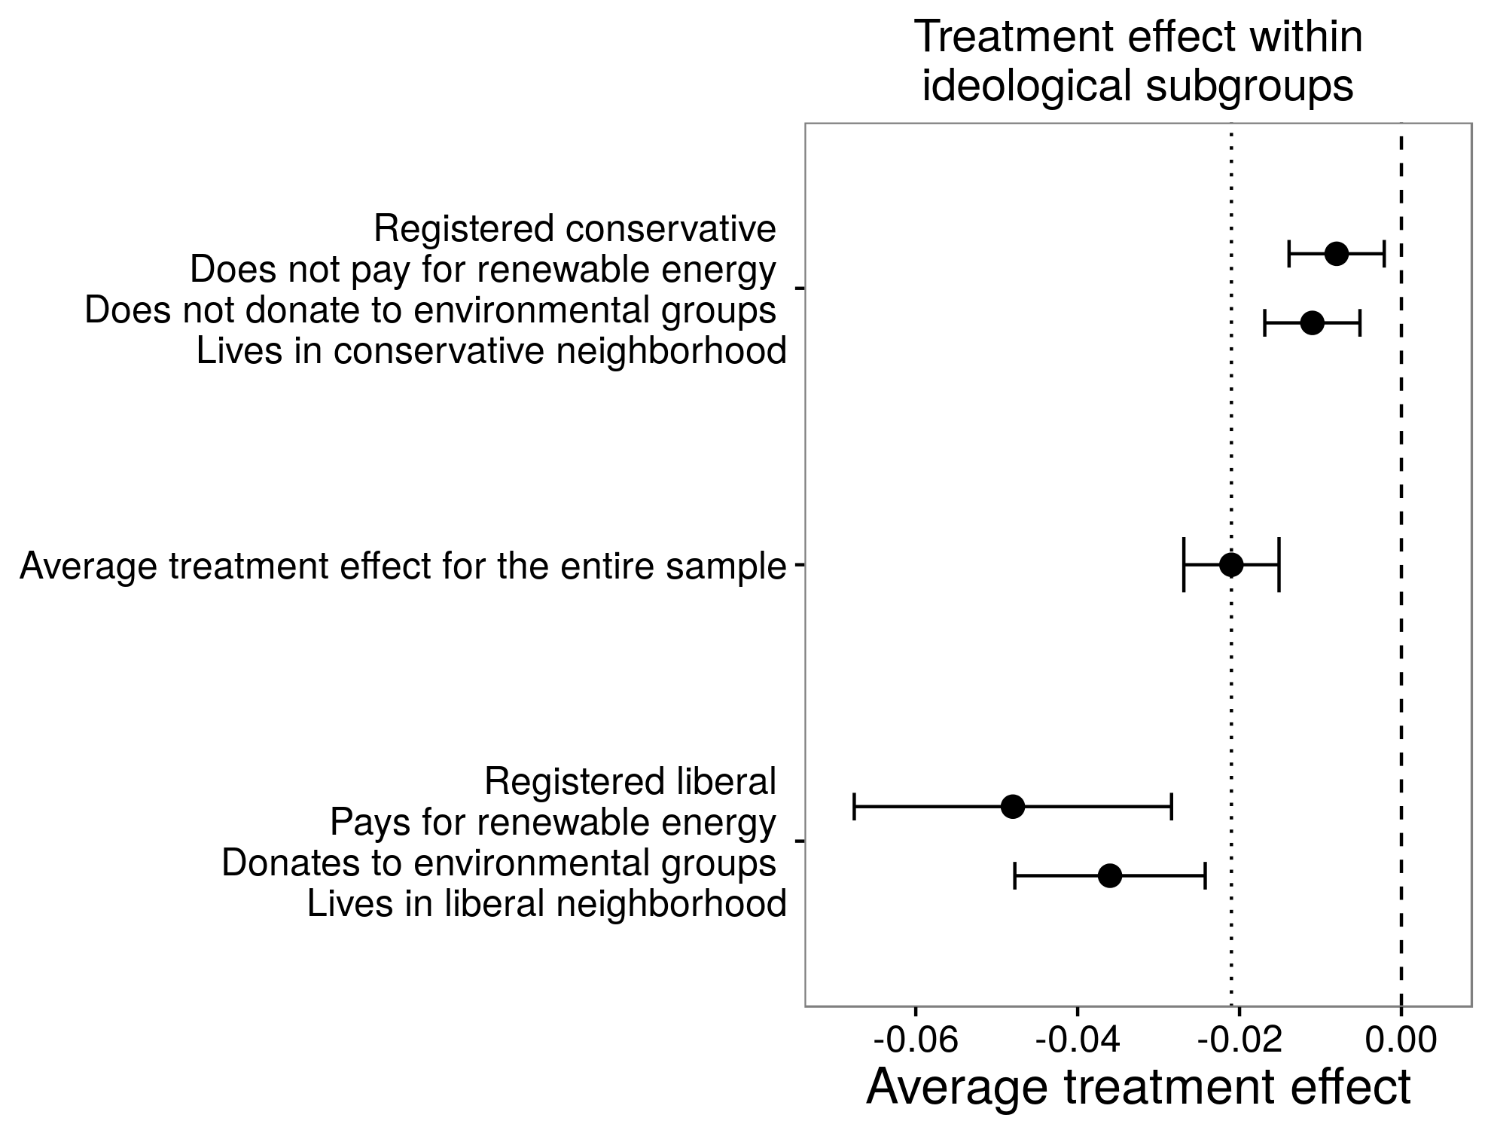
Allcott (2011)
Costa and Kahn (2013)
Light users
Heavy users

Slide 10
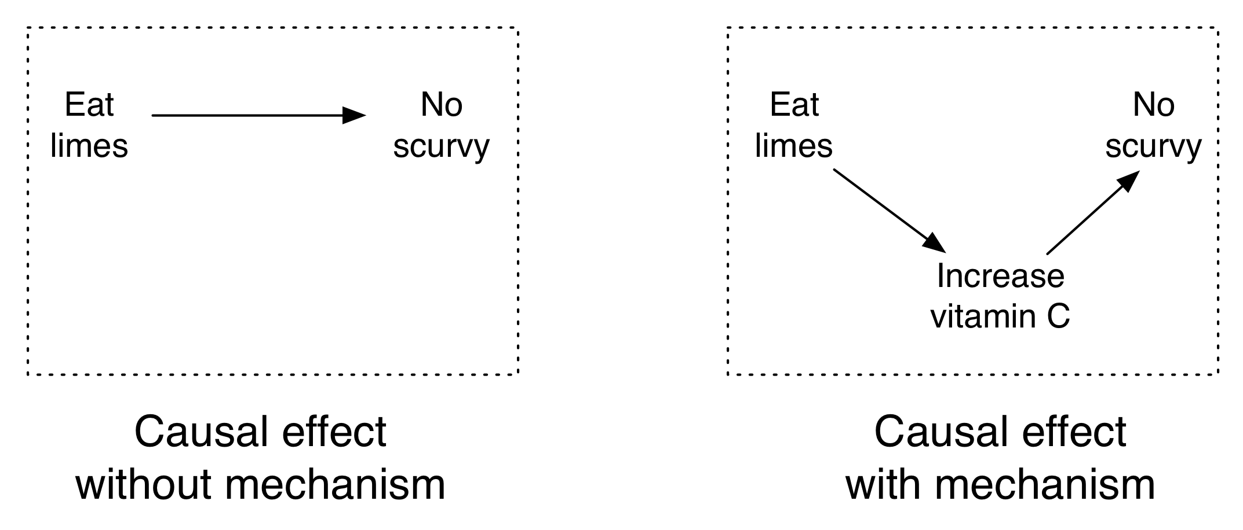
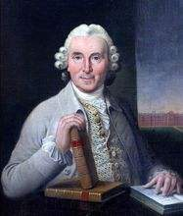
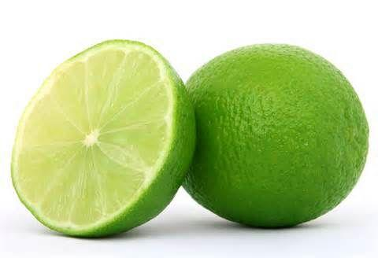
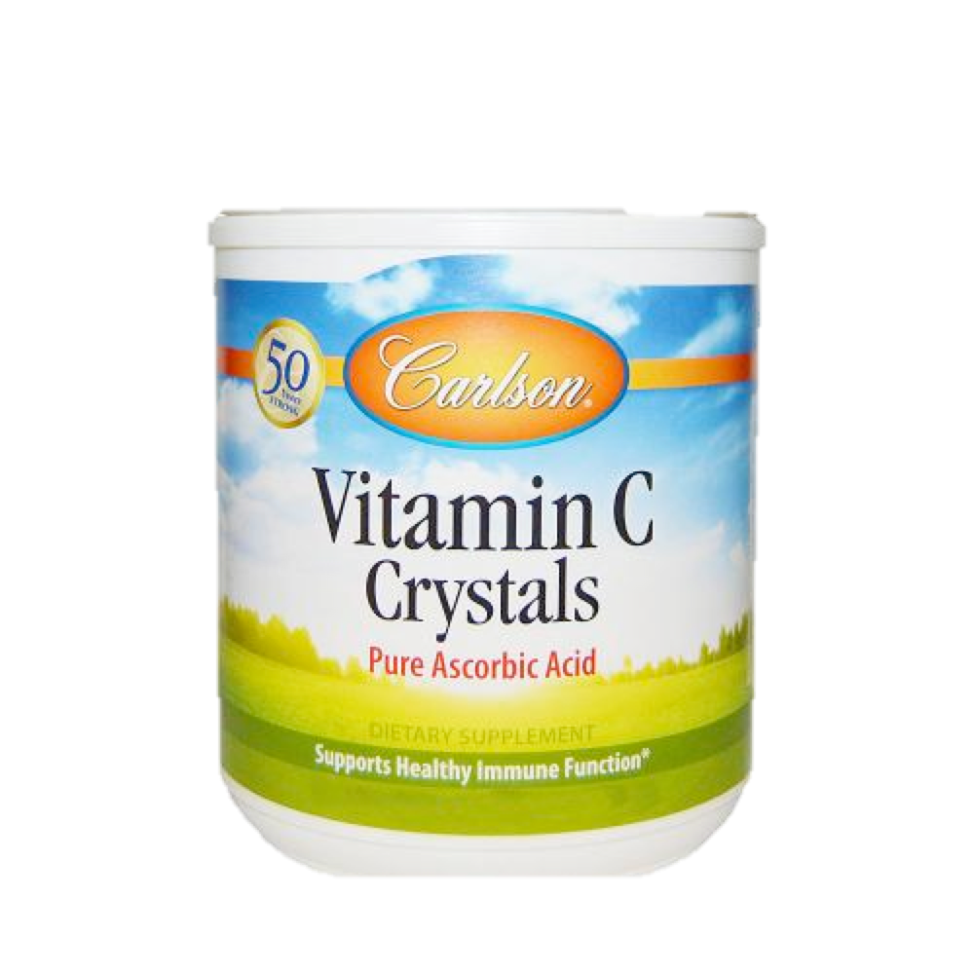
坏血病
James Lind

Slide 11
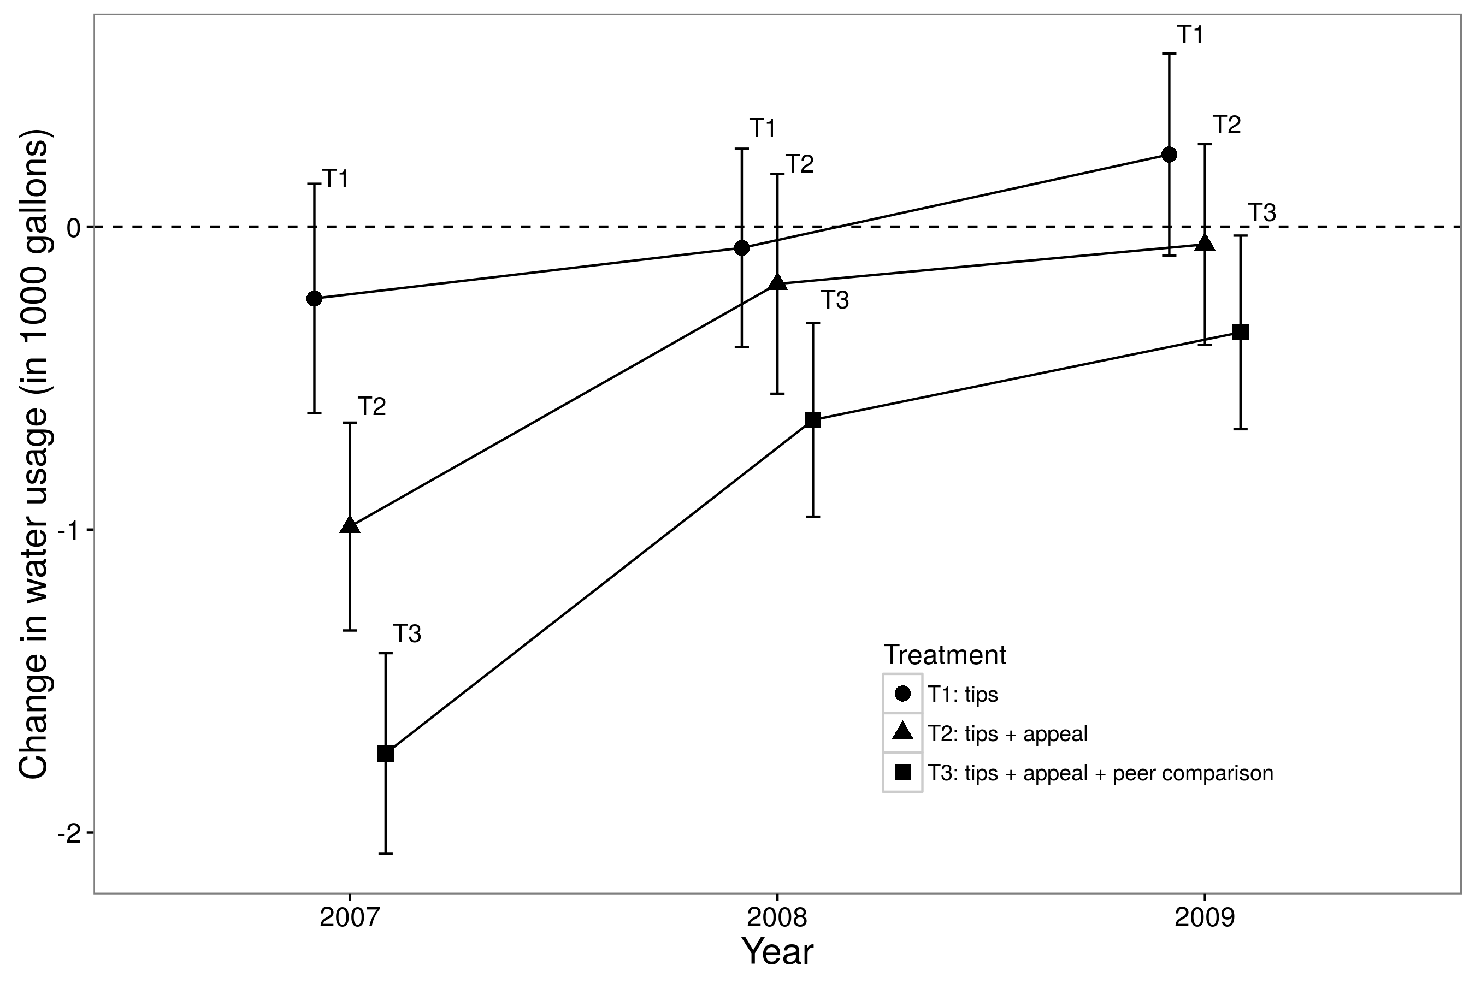

Slide 12
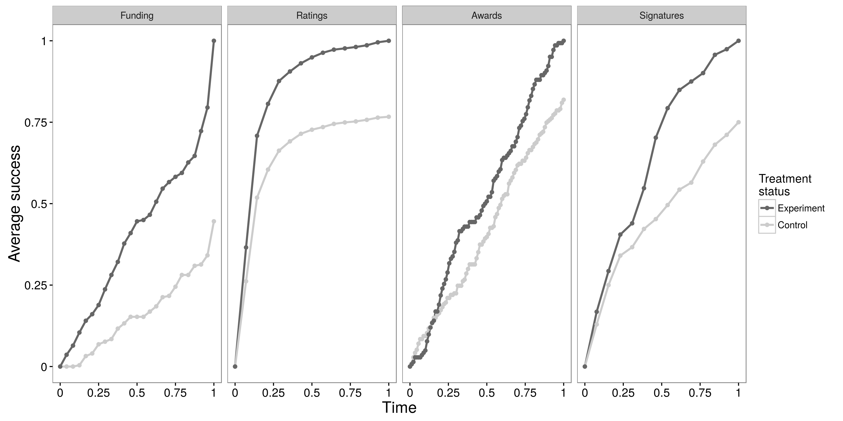
Kickstarter
Epinions
Wikipedia
change.org.

Slide 13
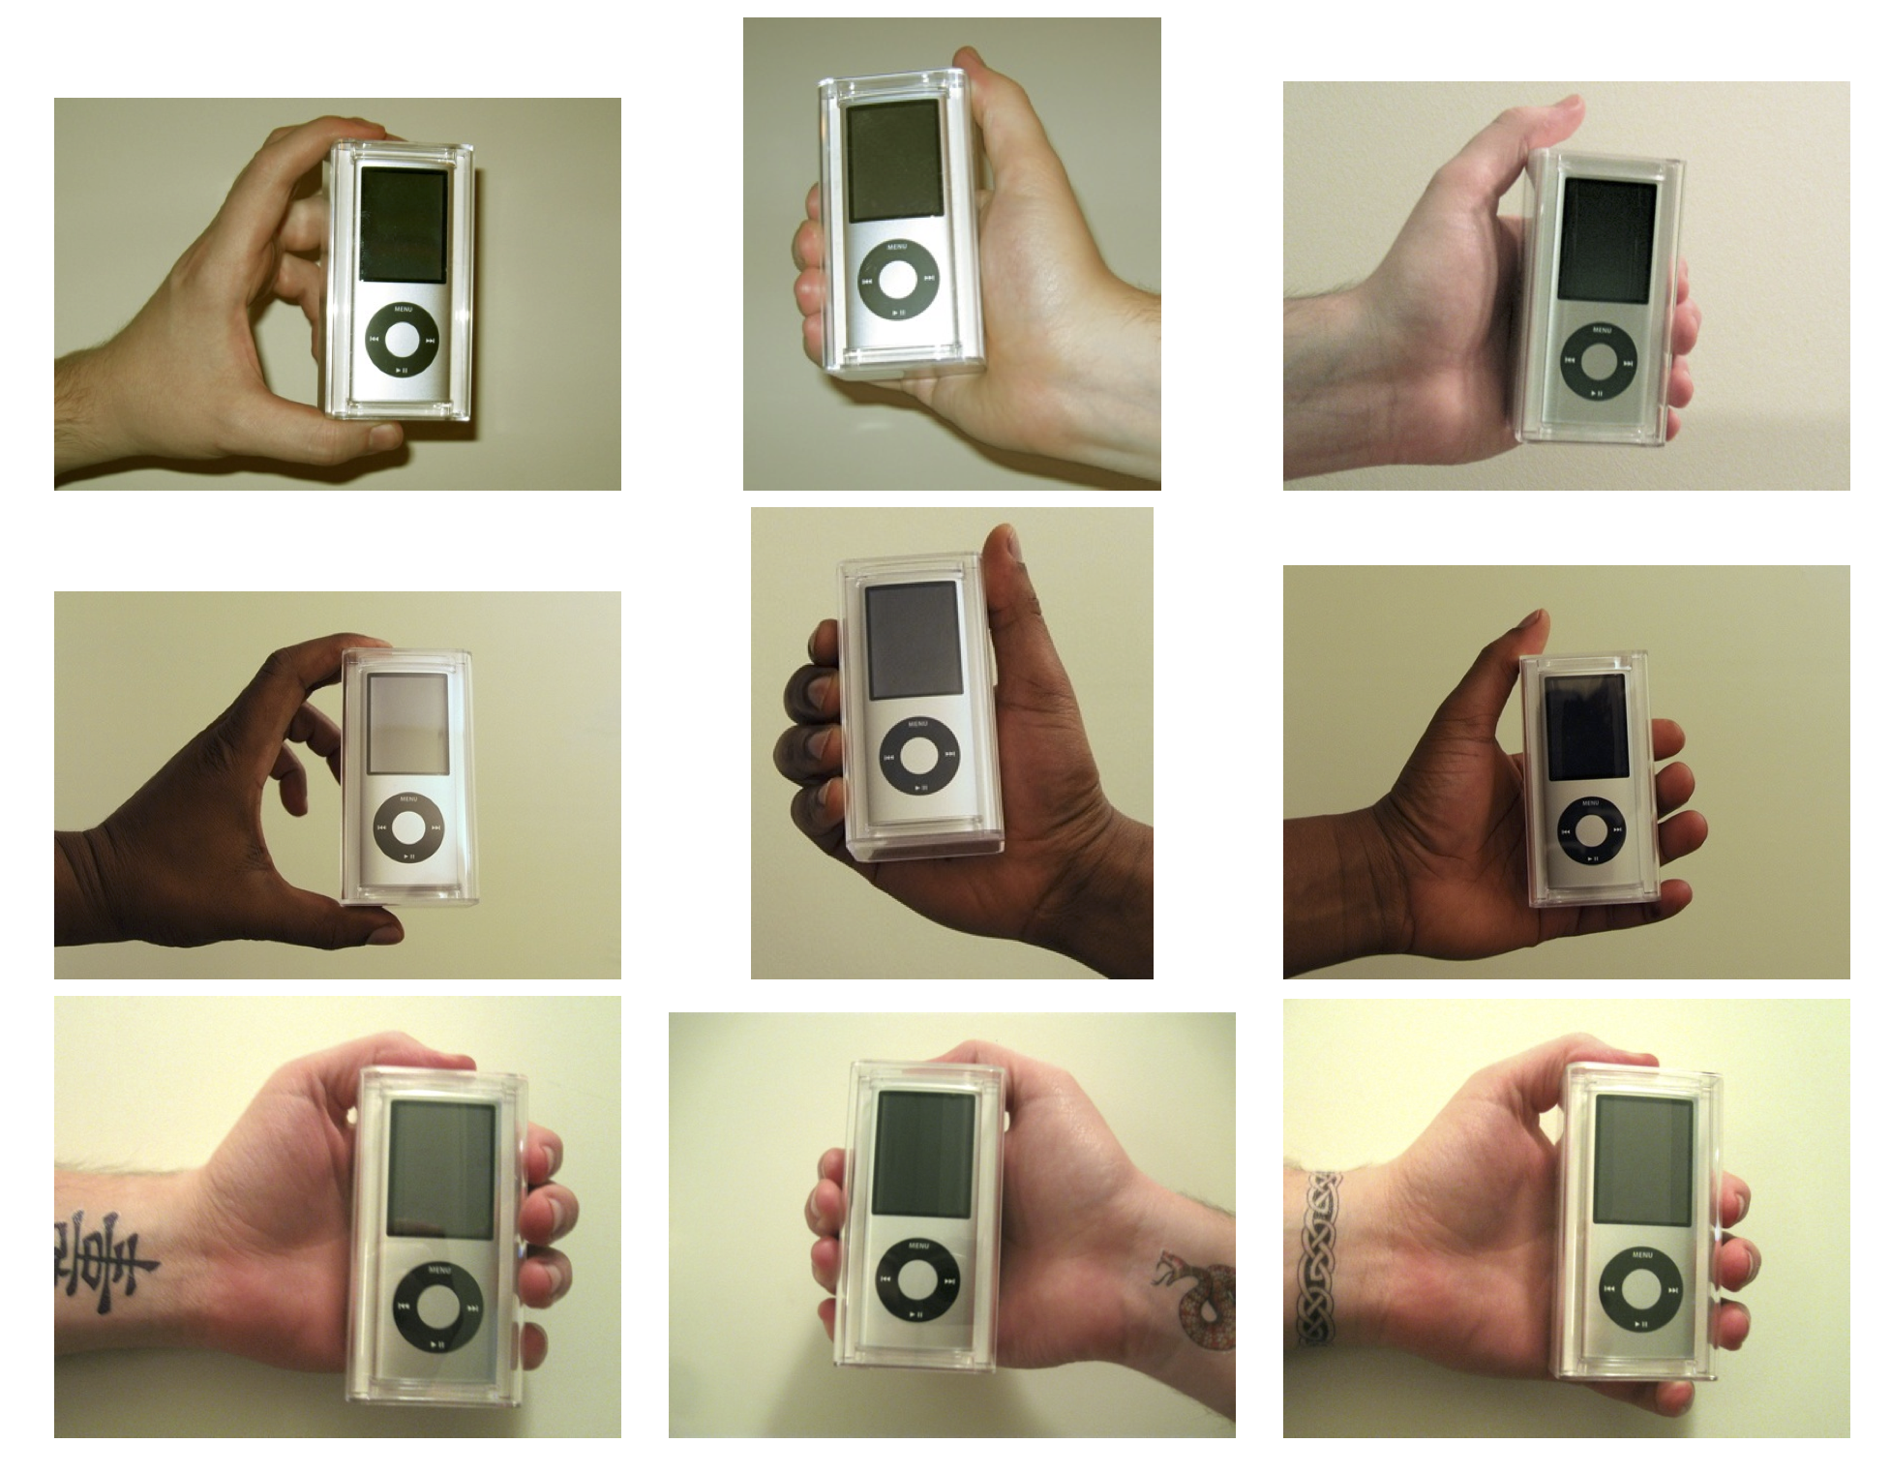

Slide 14
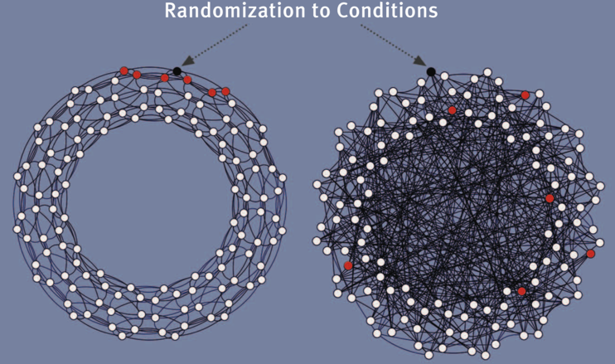
Clustered Network
Random Network

Slide 15


more research
better products
more users
A group of researchers at the University of Minnesota created MovieLens, which provides free, noncommercial personalized movie recommendations.
https://movielens.org/

Slide 16
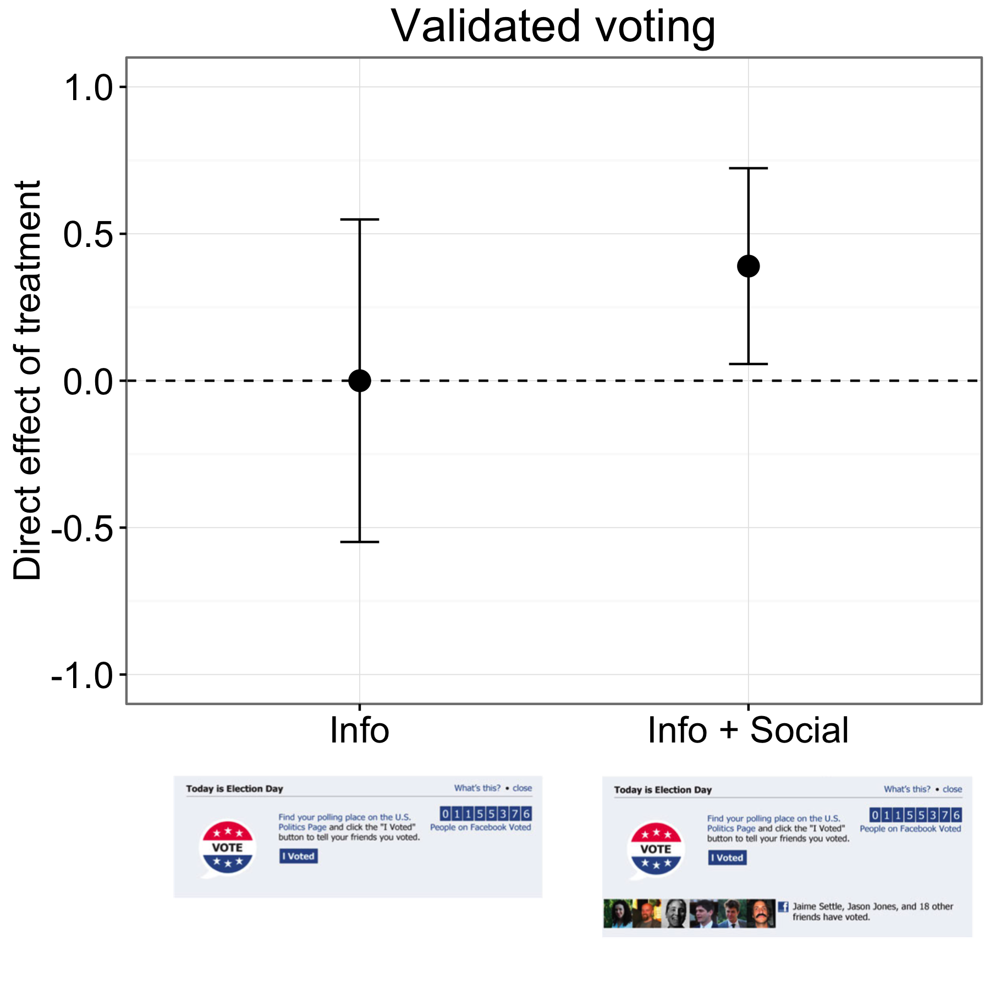
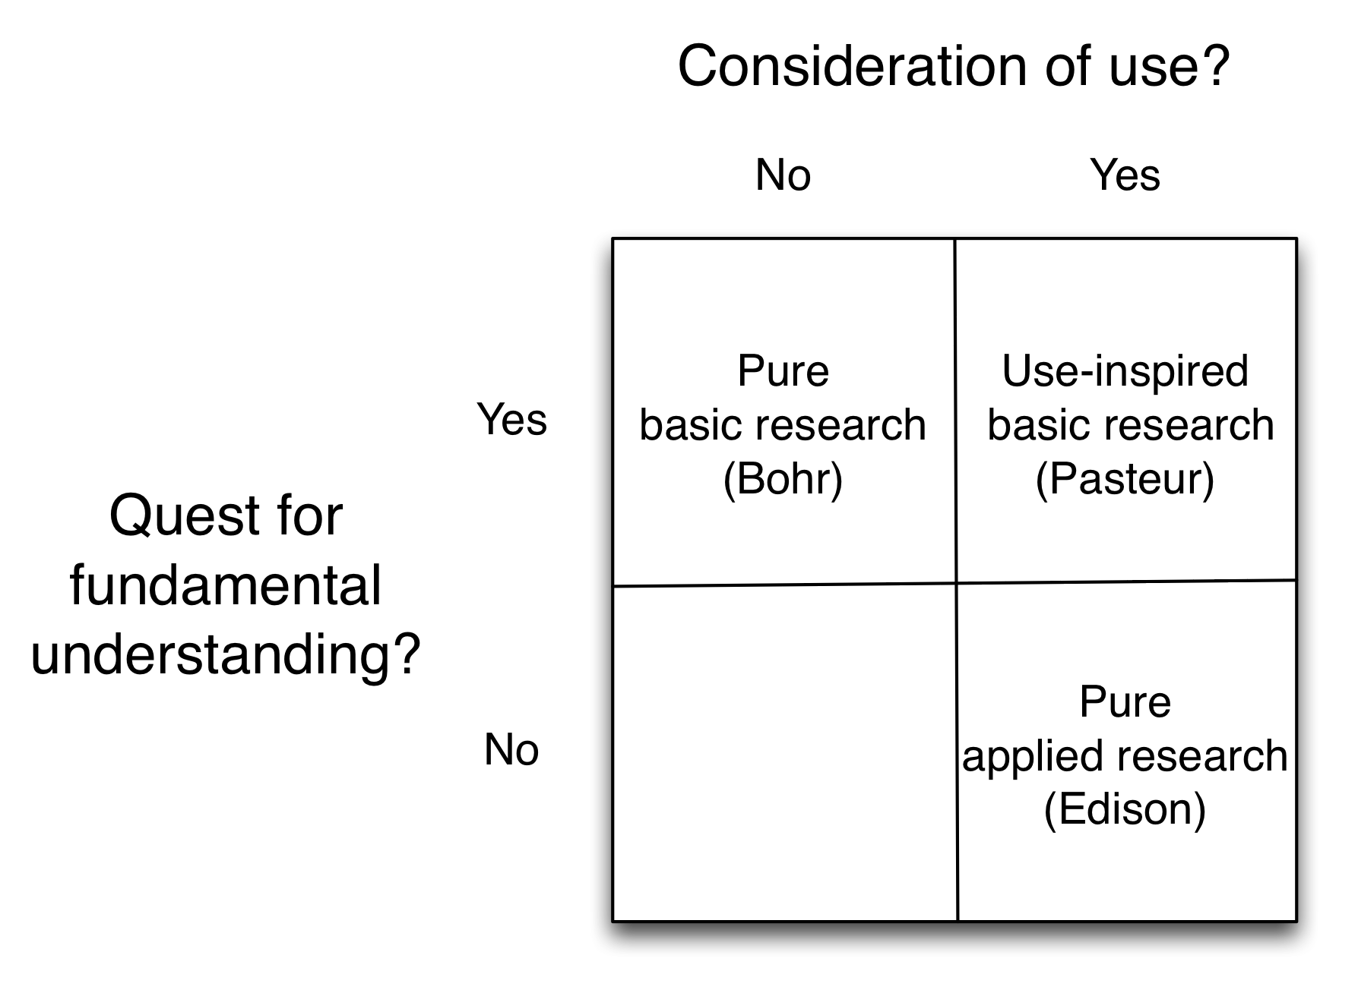
98% of the sample was assigned to Info + Social.
1%

Slide 17


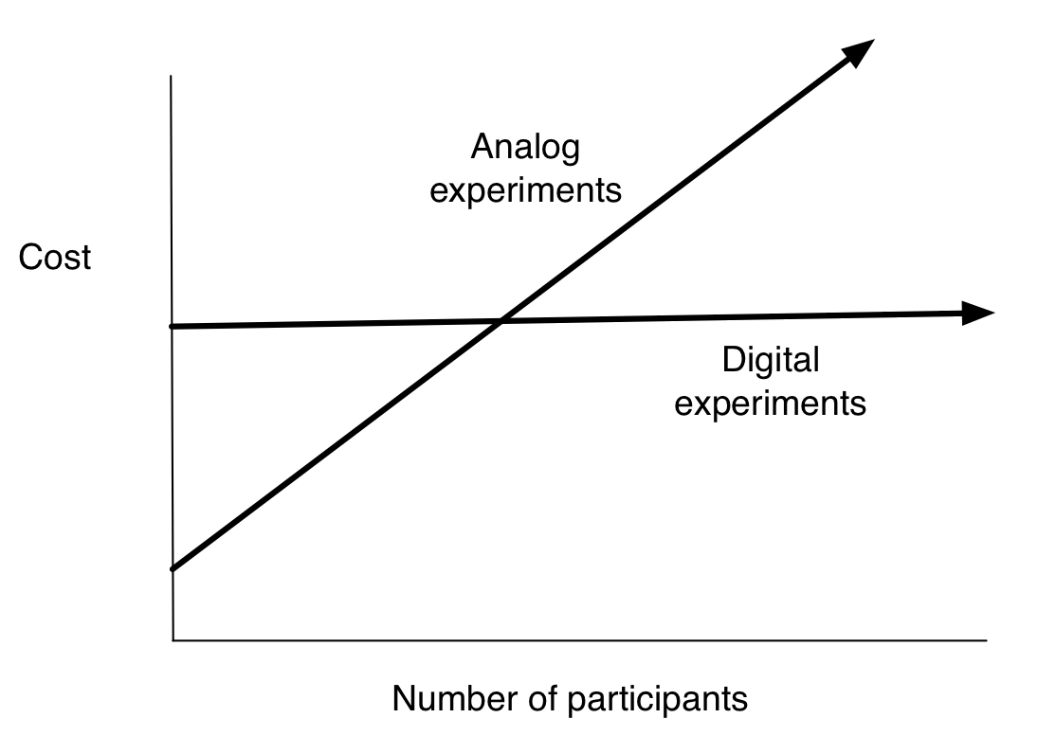
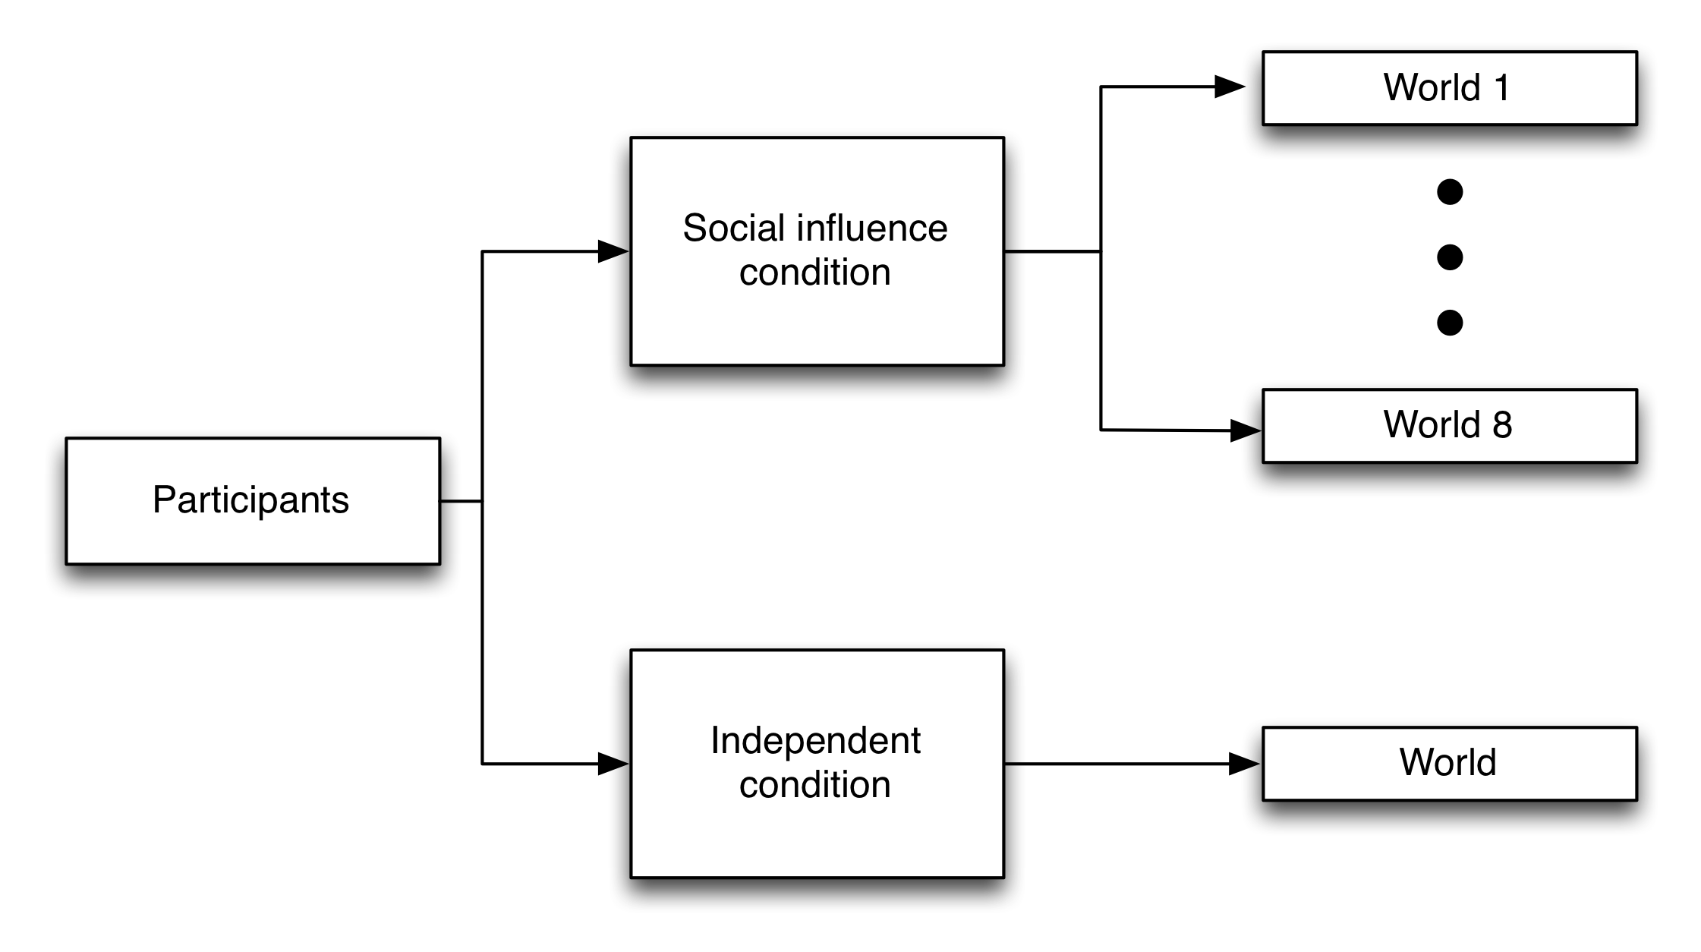
Banner Ads
Recruit participants

Slide 18
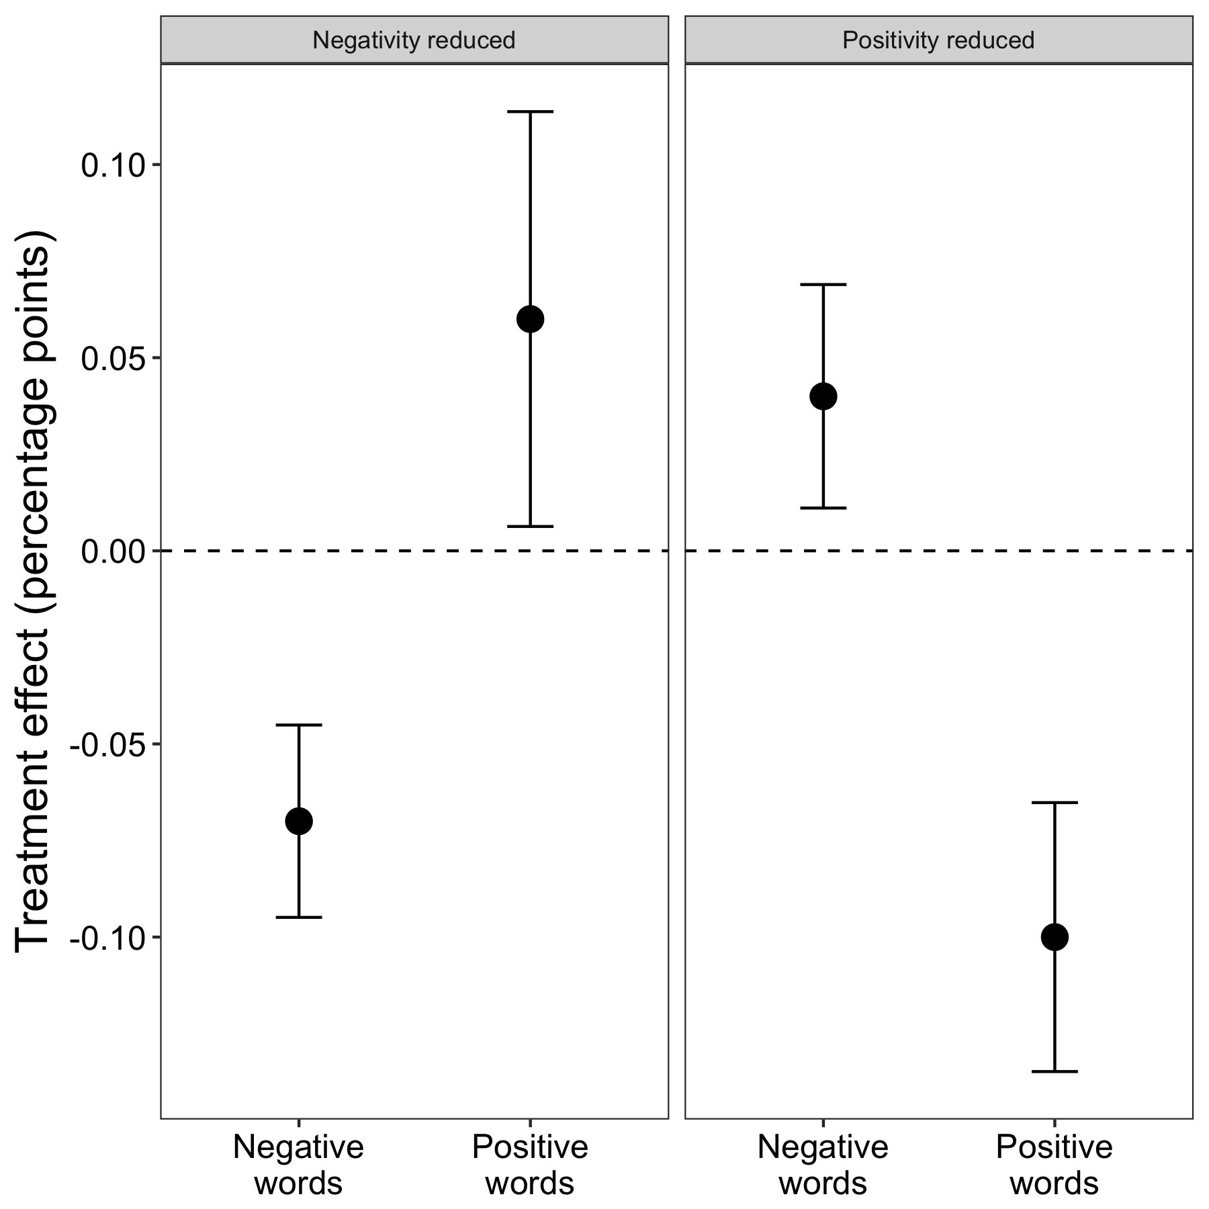
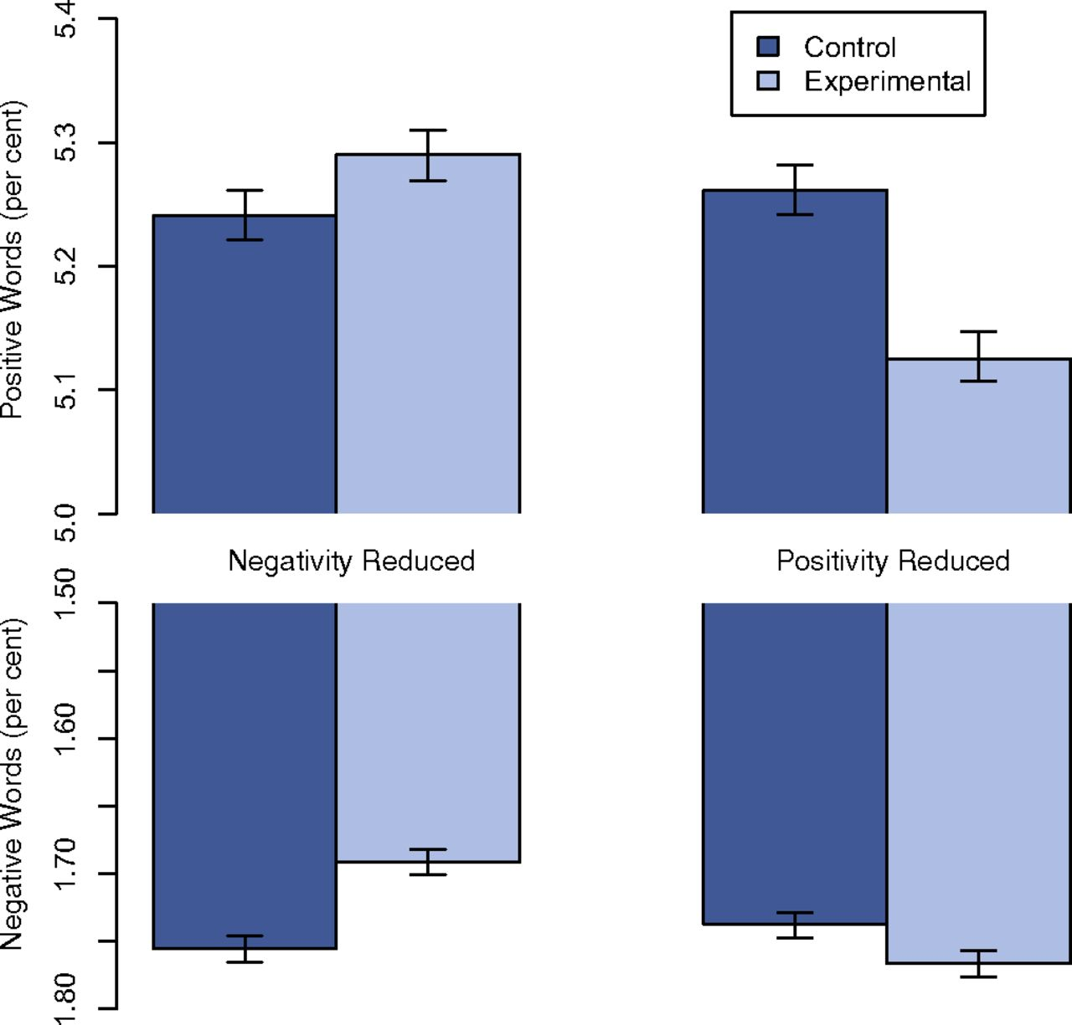

Slide 19
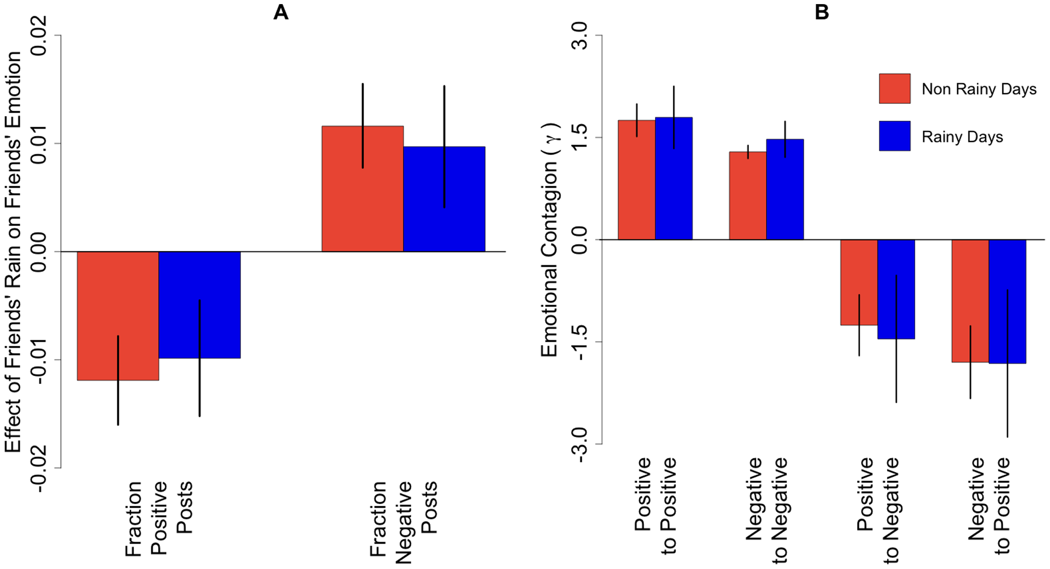
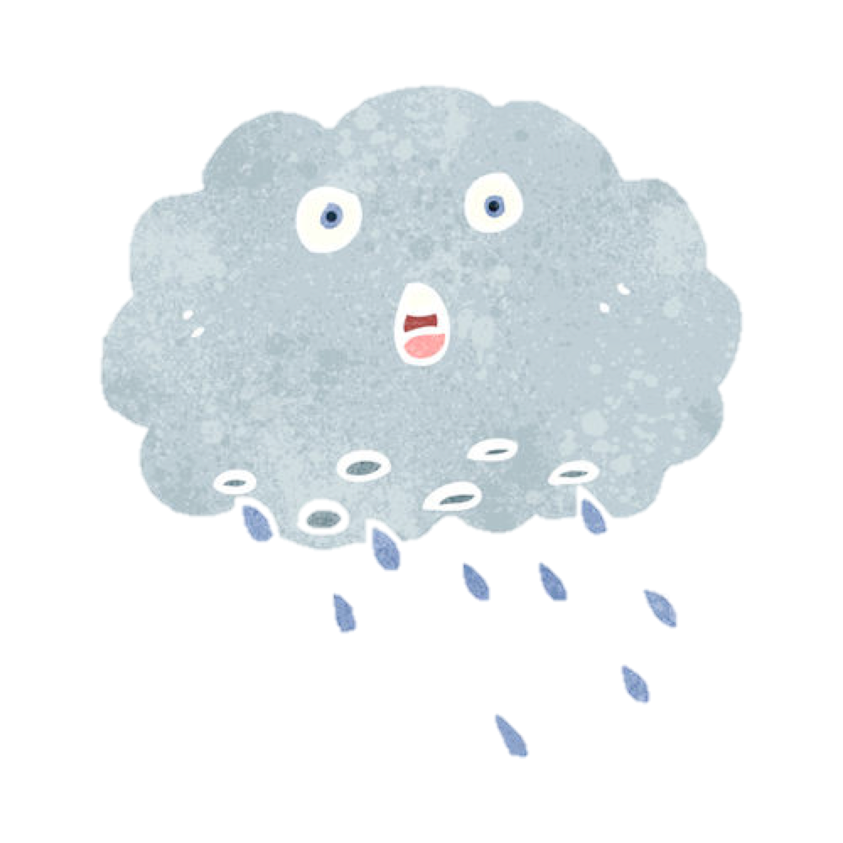




Slide 20
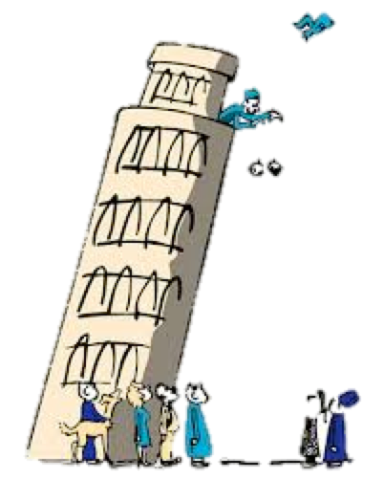
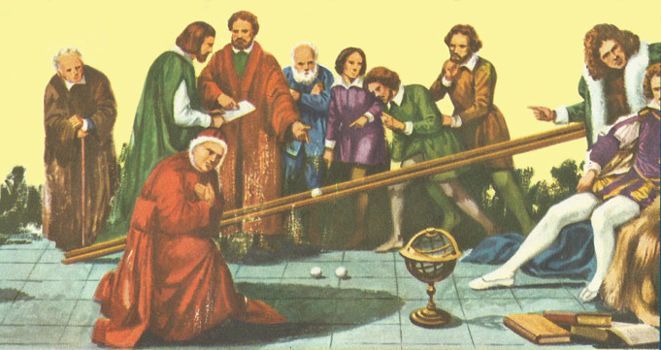
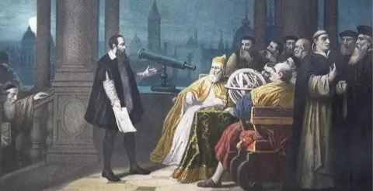
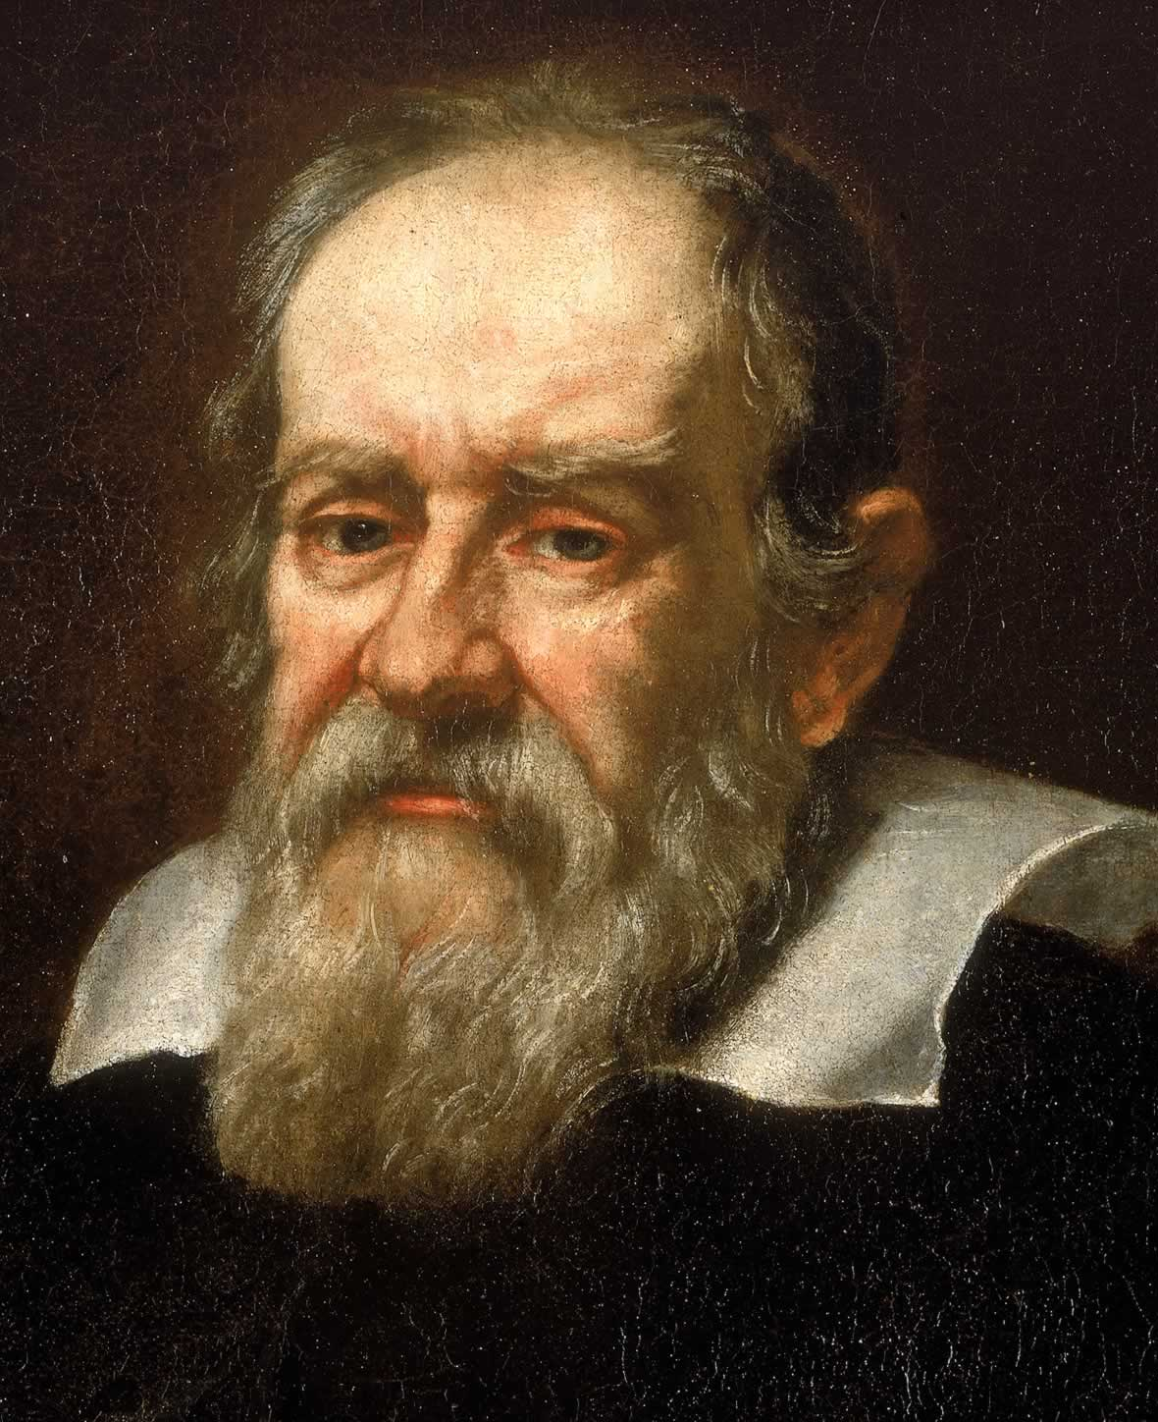


Slide 21
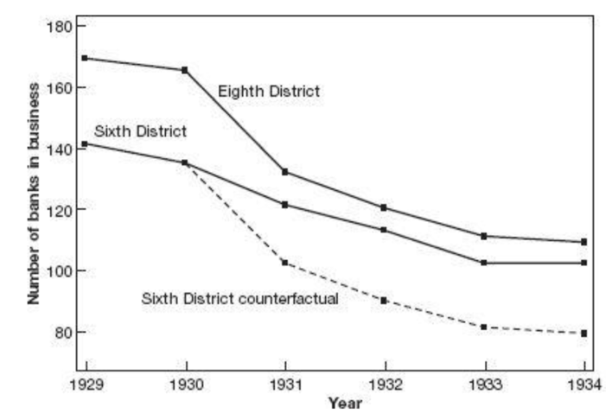
Same Policy

Slide 22
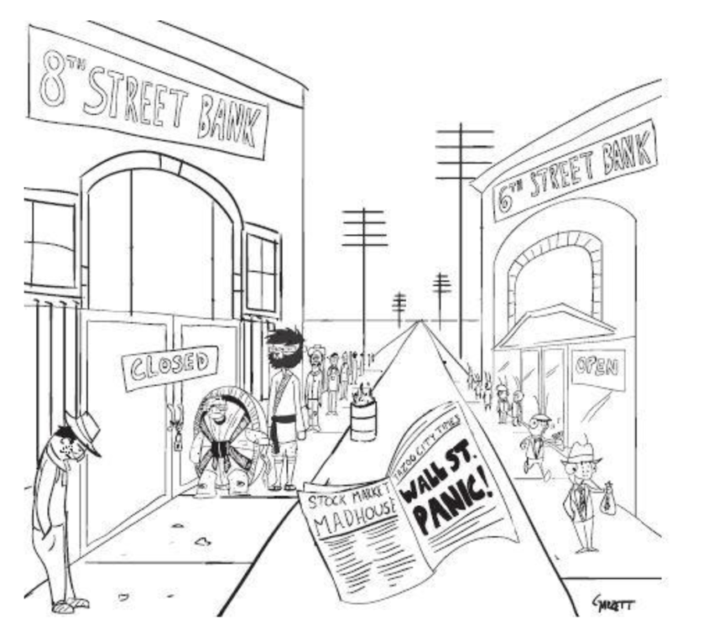
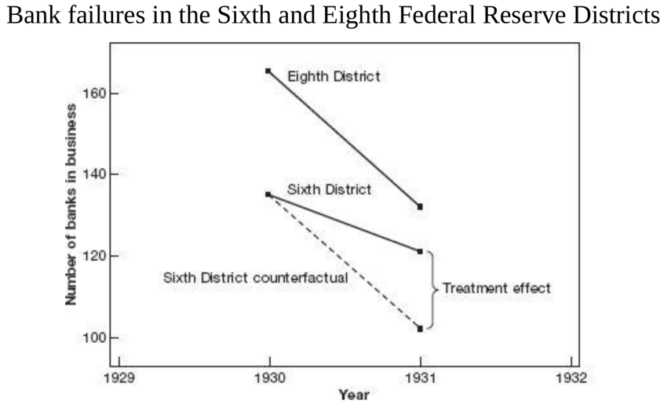

Slide 23
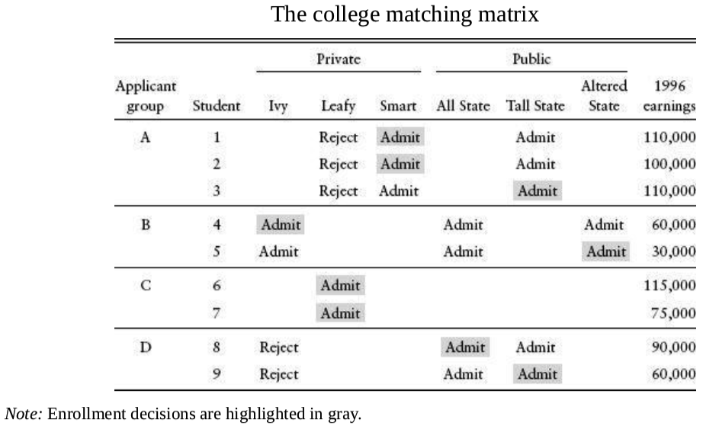
Group A, the private school differential is negative:
(110000+100000)/2−110000=−5000
Group B, the private school differential is positive:
60000−30000=30000
Group C, no public school
Group D, no private school
A tale of two colleges

Slide 24
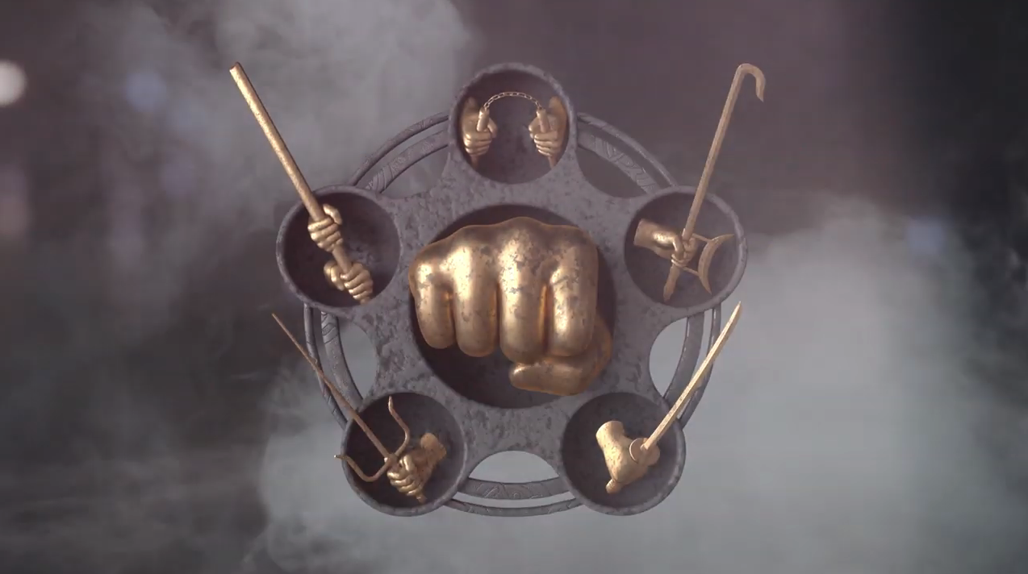
Instrumental Variables
Regression
Discontinuity
Designs
Regression
Differences-in-Differences
Random Trials

Slide 25
A tale of two colleges

Slide 26
A tale of two colleges

Slide 27
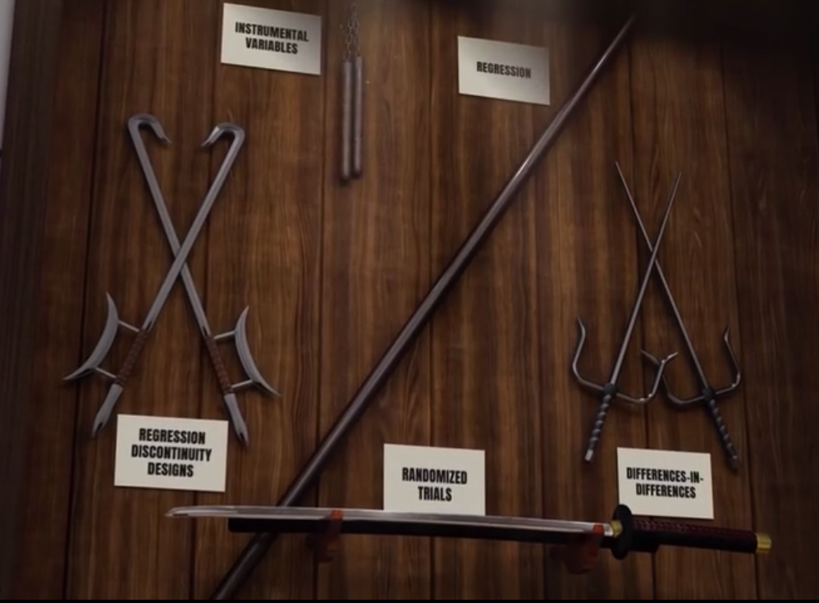

Instrumental Variables
Regression
Regression
Discontinuity
Designs
Differences-in-Differences
Random Trials

Slide 28
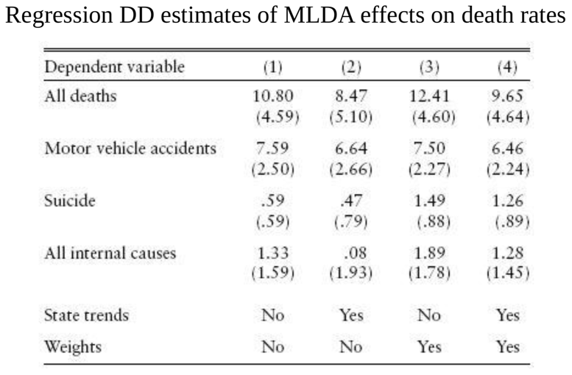
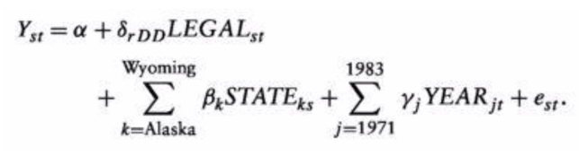
Replacing the interaction term with LEGAL_{st}
Which captures the proportions of 18-20 years old allowed to drink.

Slide 30
